Slide 1
GRADE 7 ACCELERATED · UNIT 4 · LESSON 5
Evaluating Expressions with Radicals
MA.8.NSO.1.7
I can evaluate an expression that contains square roots, cube roots and integer exponents.
Yesterday every number was a measurement.
Today the radical sign comes back — and its bar is a grouping symbol.
Grade 7 Accelerated · Unit 4 · Lesson 5 — Evaluating Expressions with Radicals
1

Slide 2
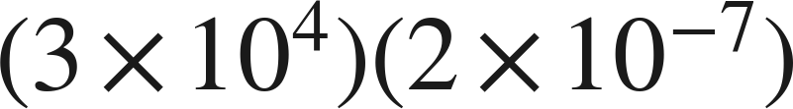


Warm-Up
On your own. Four minutes. No notes.
1. How many significant digits are in 0.0250 ?
2.
3. Find the value:
4. Evaluate:
Grade 7 Accelerated · Unit 4 · Lesson 5 — Evaluating Expressions with Radicals
2

Slide 3
Warm-Up
Answers.
1. How many significant digits are in 0.0250 ?
3
2.
6 × 10⁻³
3. Find the value:
14
4. Evaluate:
8
Grade 7 Accelerated · Unit 4 · Lesson 5 — Evaluating Expressions with Radicals
3

Slide 4
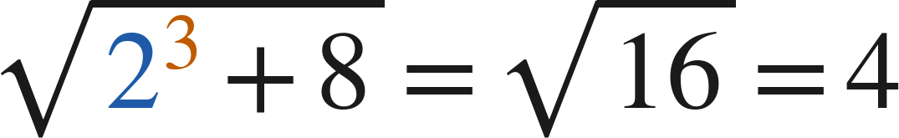
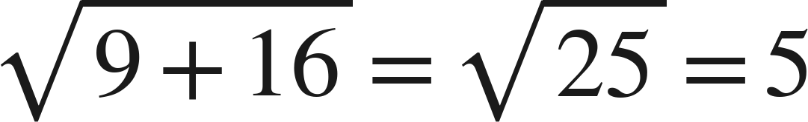

Notes
Copy all three lines.
I. The radical bar is a grouping symbol
, never
Everything under the bar is evaluated before the root is taken.
Grade 7 Accelerated · Unit 4 · Lesson 5 — Evaluating Expressions with Radicals
4

Slide 5
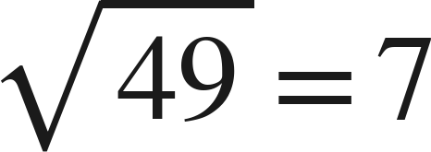
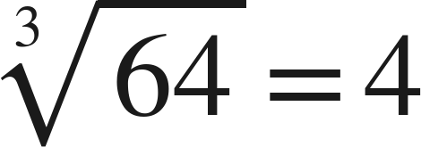
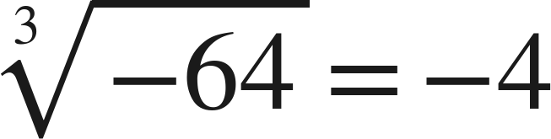
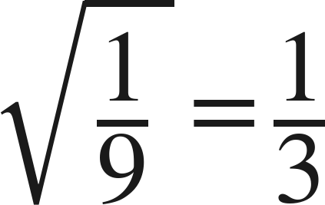
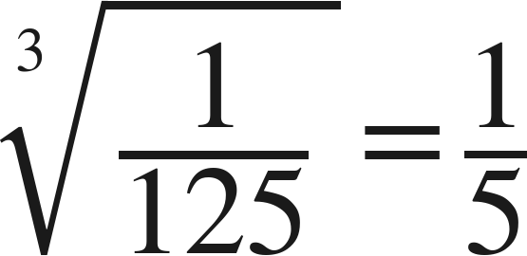
Notes
II. Square roots and cube roots are not the same shape
An odd root keeps the sign of its radicand. A square root sign never gives a negative value.
Grade 7 Accelerated · Unit 4 · Lesson 5 — Evaluating Expressions with Radicals
5

Slide 6
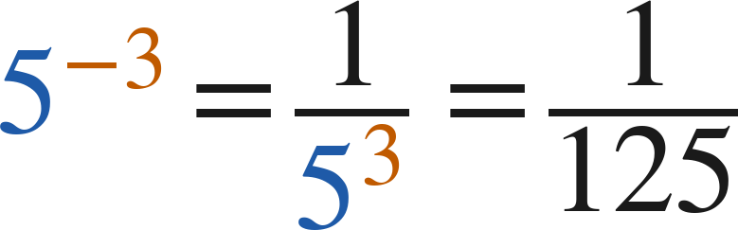
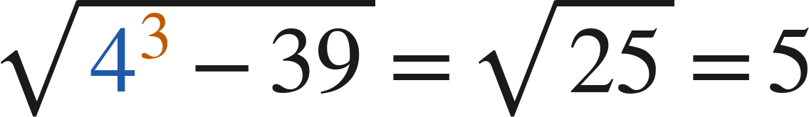
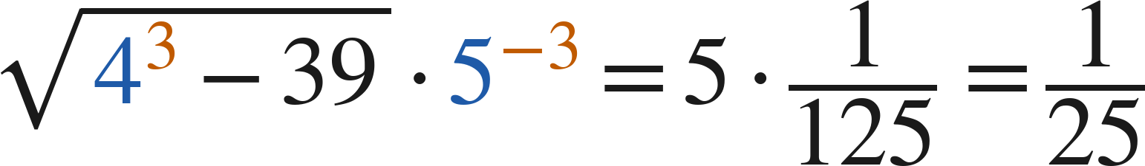
Notes
III. Radicals alongside exponents
Finish each piece — the radical, the power — and only then put them together.
Grade 7 Accelerated · Unit 4 · Lesson 5 — Evaluating Expressions with Radicals
6

Slide 7
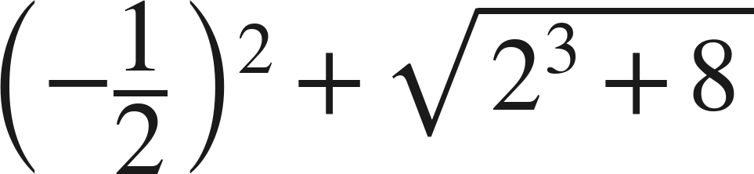
Example 1
A power and a radical in one expression.
Evaluate.
Grade 7 Accelerated · Unit 4 · Lesson 5 — Evaluating Expressions with Radicals
7

Slide 8
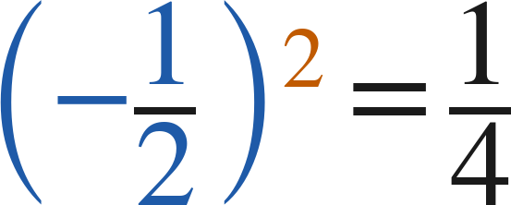
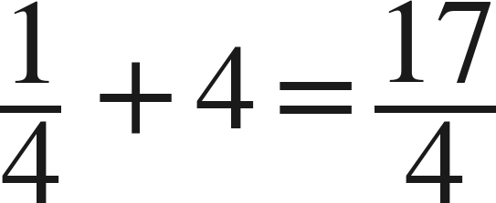
Example 1
Worked.
square the whole base, sign included
finish under the bar, then take the root
combine
Answer: 17/4
Grade 7 Accelerated · Unit 4 · Lesson 5 — Evaluating Expressions with Radicals
8

Slide 9
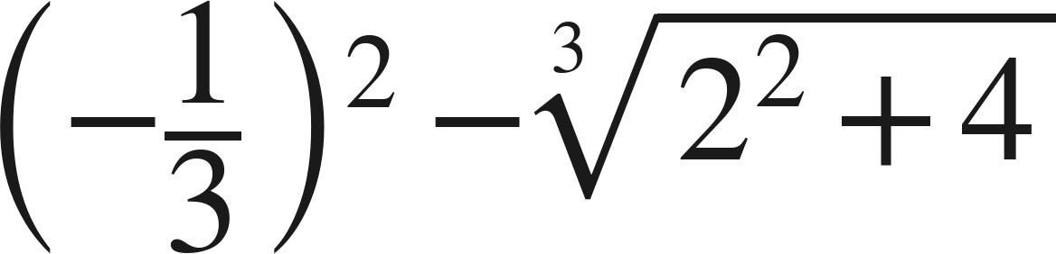
Your Turn
Same steps, your numbers. Boards up when done.
Grade 7 Accelerated · Unit 4 · Lesson 5 — Evaluating Expressions with Radicals
9

Slide 10
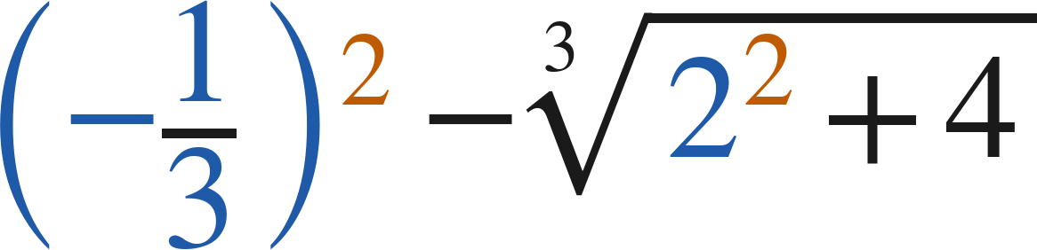
Your Turn
Answer.
1/9 minus 2
Answer: −17/9
Grade 7 Accelerated · Unit 4 · Lesson 5 — Evaluating Expressions with Radicals
10

Slide 11
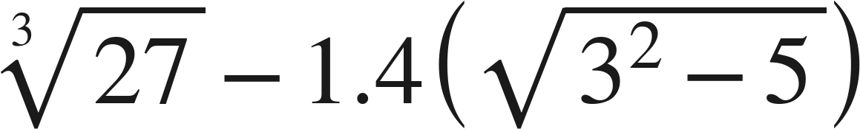
Example 2
A radical inside a product.
Evaluate.
Grade 7 Accelerated · Unit 4 · Lesson 5 — Evaluating Expressions with Radicals
11

Slide 12
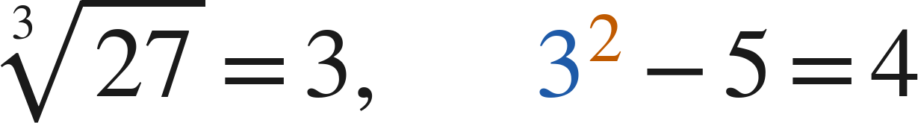
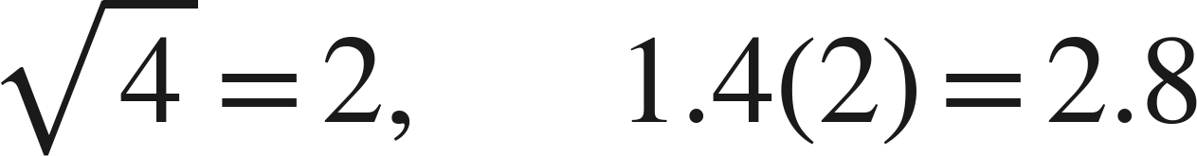

Example 2
Worked.
the two innermost pieces
the root, then the product
subtract last
Answer: 0.2
Grade 7 Accelerated · Unit 4 · Lesson 5 — Evaluating Expressions with Radicals
12

Slide 13
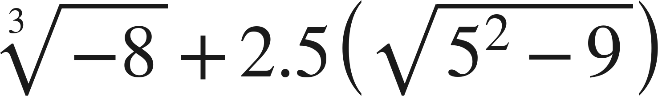
Your Turn
Same steps, your numbers. Boards up when done.
Grade 7 Accelerated · Unit 4 · Lesson 5 — Evaluating Expressions with Radicals
13

Slide 14
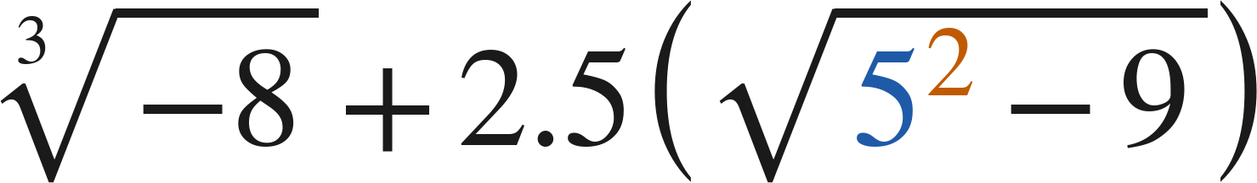
Your Turn
Answer.
−2 plus 10
Answer: 8
Grade 7 Accelerated · Unit 4 · Lesson 5 — Evaluating Expressions with Radicals
14

Slide 15
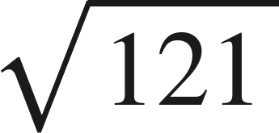
Whiteboards · Question 1 of 9
Boards up on three.
Answer it.
What times itself?
Grade 7 Accelerated · Unit 4 · Lesson 5 — Evaluating Expressions with Radicals
15

Slide 16
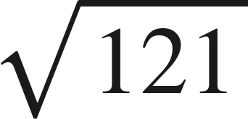
Whiteboards · Question 1 of 9
Answer.
11 · 11
Answer: 11
Grade 7 Accelerated · Unit 4 · Lesson 5 — Evaluating Expressions with Radicals
16

Slide 17
Whiteboards · Question 2 of 9
Boards up on three.
A square patio has an area of 169 square feet.
Fencing for it costs 12 dollars a foot.
How long is one side of the patio?
Answer it.
Grade 7 Accelerated · Unit 4 · Lesson 5 — Evaluating Expressions with Radicals
17

Slide 18
Whiteboards · Question 2 of 9
Answer.
A square patio has an area of 169 square feet.
Fencing for it costs 12 dollars a foot.
How long is one side of the patio?
√169
Answer: 13 feet
Grade 7 Accelerated · Unit 4 · Lesson 5 — Evaluating Expressions with Radicals
18

Slide 19
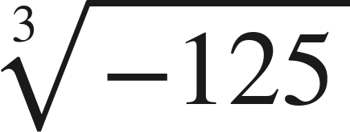
Whiteboards · Question 3 of 9
Boards up on three.
Answer it.
What number, three times?
Grade 7 Accelerated · Unit 4 · Lesson 5 — Evaluating Expressions with Radicals
19

Slide 20
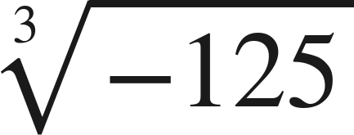
Whiteboards · Question 3 of 9
Answer.
(−5)(−5)(−5)
Answer: −5
Grade 7 Accelerated · Unit 4 · Lesson 5 — Evaluating Expressions with Radicals
20

Slide 21
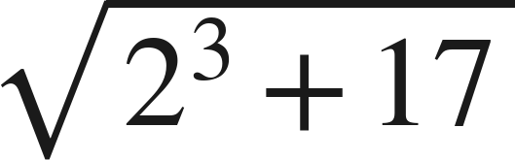
Whiteboards · Question 4 of 9
Boards up on three.
Answer it.
Finish under the bar first.
Grade 7 Accelerated · Unit 4 · Lesson 5 — Evaluating Expressions with Radicals
21

Slide 22
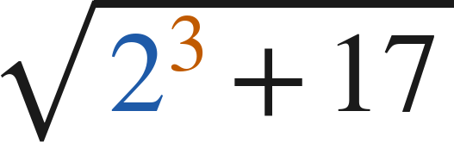
Whiteboards · Question 4 of 9
Answer.
8 + 17 = 25
Answer: 5
Grade 7 Accelerated · Unit 4 · Lesson 5 — Evaluating Expressions with Radicals
22

Slide 23
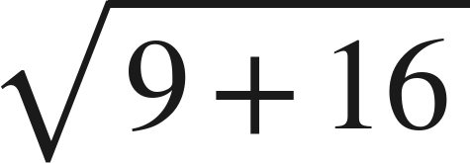
Whiteboards · Question 5 of 9
Boards up on three.
Which is the value?
A. 7
B. 25
C. 12.5
D. 5
Answer it.
Grade 7 Accelerated · Unit 4 · Lesson 5 — Evaluating Expressions with Radicals
23

Slide 24

Whiteboards · Question 5 of 9
Answer.
Which is the value?
A. 7
B. 25
C. 12.5
D. 5
Answer: D — 5
Grade 7 Accelerated · Unit 4 · Lesson 5 — Evaluating Expressions with Radicals
24

Slide 25
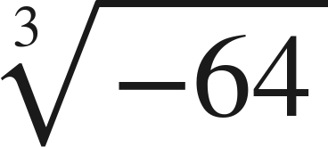
Whiteboards · Question 6 of 9
Boards up on three.
Which is the value?
A. −4
B. not a real number
C. −8
D. 4
Answer it.
Grade 7 Accelerated · Unit 4 · Lesson 5 — Evaluating Expressions with Radicals
25

Slide 26

Whiteboards · Question 6 of 9
Answer.
Which is the value?
A. −4
B. not a real number
C. −8
D. 4
Answer: A — −4
Grade 7 Accelerated · Unit 4 · Lesson 5 — Evaluating Expressions with Radicals
26

Slide 27
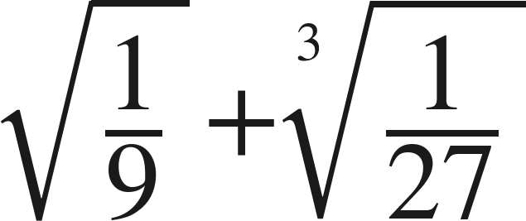
Whiteboards · Question 7 of 9
Boards up on three.
Answer it.
Top and bottom each get the root.
Grade 7 Accelerated · Unit 4 · Lesson 5 — Evaluating Expressions with Radicals
27

Slide 28

Whiteboards · Question 7 of 9
Answer.
1/3 and 1/3
Answer: 2/3
Grade 7 Accelerated · Unit 4 · Lesson 5 — Evaluating Expressions with Radicals
28

Slide 29
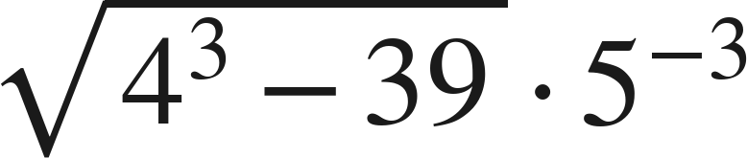
Whiteboards · Question 8 of 9
Boards up on three.
Answer it.
Finish each piece, then multiply.
Grade 7 Accelerated · Unit 4 · Lesson 5 — Evaluating Expressions with Radicals
29

Slide 30
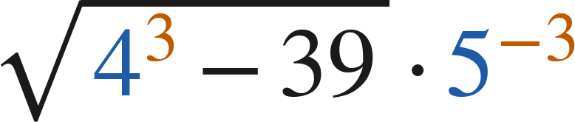
Whiteboards · Question 8 of 9
Answer.
5 times one hundred twenty-fifth
Answer: 1/25
Grade 7 Accelerated · Unit 4 · Lesson 5 — Evaluating Expressions with Radicals
30

Slide 31
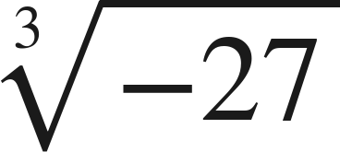
Whiteboards · Question 9 of 9
Take your time. Boards up when you have written it.
Simon says that
is not a real number,
because you cannot take the root of a negative.
Explain why he is wrong, and give the value.
Write your answer in sentences.
Which root is he thinking of?
Grade 7 Accelerated · Unit 4 · Lesson 5 — Evaluating Expressions with Radicals
31

Slide 32
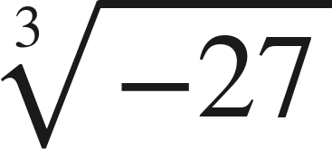
Whiteboards · Question 9 of 9
Answer.
Simon says that
is not a real number,
because you cannot take the root of a negative.
Explain why he is wrong, and give the value.
a cube root is not a square root
Answer: −3
Grade 7 Accelerated · Unit 4 · Lesson 5 — Evaluating Expressions with Radicals
32

Slide 33
Independent Set
Six questions. On your own, in silence.
1.
Six questions. Work down the page.
2.
Show the step that does the work, not just the answer.
3.
Silence until the six minutes are up.
Grade 7 Accelerated · Unit 4 · Lesson 5 — Evaluating Expressions with Radicals
33

Slide 34
IXL
Last five minutes.
1.
Open IXL and start today's skills.
2.
Work on paper where the question needs work. The answer box does not show it.
3.
Every skill listed is required, to a SmartScore of 67. This skill continues tomorrow: one assignment, due at the start of the class after 4.06.
Today's skills — all required
Evaluate radical expressions — D8J
Grade 7 Accelerated · Unit 4 · Lesson 5 — Evaluating Expressions with Radicals
34

